Slide 1
Regional Video Game Sales
Cluster Analysis

Slide 2
Business Case
We aim to use Cluster Analysis and Unsupervised Learning techniques to uncover hidden patterns and structures within the data. This will help in identifying segments of games based on sales performance, platform usage, and genre popularity, which can inform decision-making processes for game publishers.

Slide 3
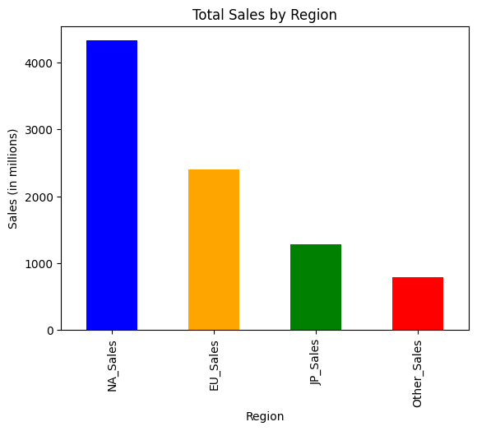
Exploratory Analysis
The graph depicts sales within the different regions, and we can see that the North American region has the most sales.
This could be due to the popularity of video game culture within the region.

Slide 4
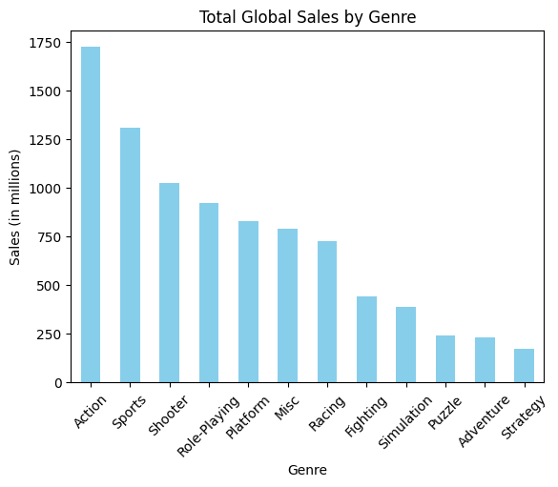
Exploratory Analysis
This graph shows the video game sales by region, with the Action video games having the most amount of sales.

Slide 5
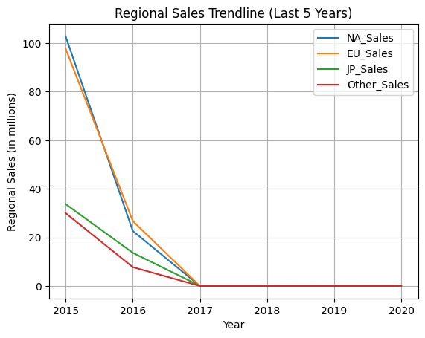
Exploratory Analysis
This graph shows the trends of the amount of games sold in each region, with a noticeable trend downwards within the last five years of the dataset.
Upon further investigation the data set has missing values from 2017 to 2020

Slide 6
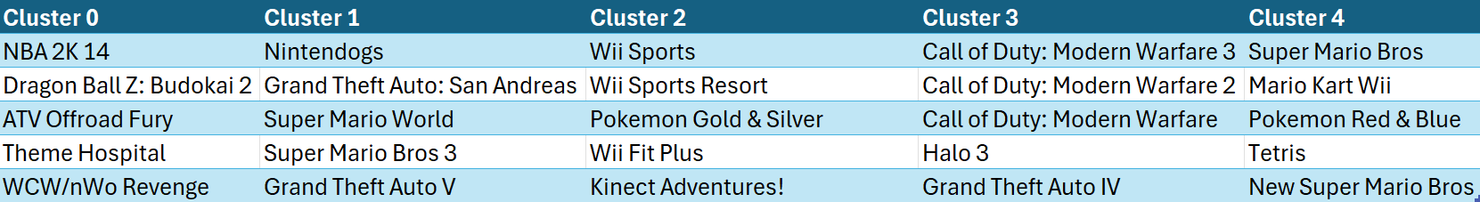
Clusters

Slide 7
Cluster Interpretations: Cluster 0
This cluster seems to contain video games with lower global sales on average.
The NA_Sales and EU_Sales are also relatively low, with some negative or close-to-zero values, indicating that these games may not have performed well in those regions.
These games tend to have very low Global Sales.
Games in this cluster could be underperformers in the market, possibly niche games or games with limited appeal.
Their low regional and global sales might reflect limited distribution, niche genres, or other factors affecting their sales performance.

Slide 8
Cluster Interpretations: Cluster 1
This cluster consists of games with high global sales, especially those with strong performance in NA_Sales and EU_Sales.
Many of these games, such as:
Nintendogs, Grand Theft Auto: San Andreas, and Super Mario World,
are well-known, successful titles with a broad fanbase.
This cluster contains highly popular games that have had substantial sales success across different regions.
These games are likely to have a strong global presence, indicating their widespread popularity and marketing success.
The presence of games with multi-million unit sales suggests that this cluster includes mainstream, best-selling games.

Slide 9
Cluster Interpretations: Cluster 2
This cluster is characterized by games with very high global sales, particularly titles that are very successful in NA_Sales and EU_Sales (e.g., Wii Sports, Wii Sports Resort).
These games tend to have very high JP_Sales as well, particularly for Nintendo-based titles, showing a dominant market presence in Japan.
Cluster 2 contains blockbuster games that likely have global recognition and very strong sales across multiple regions.
The games in this cluster are likely from popular franchises, especially from Nintendo, which tends to perform well across all markets.
These games are highly influential and have captured large, broad audiences, resulting in massive global sales.

Slide 10
Cluster Interpretations: Cluster 3
This cluster contains moderate to high sales games, with a strong presence in NA_Sales and EU_Sales.
Games like Call of Duty: Modern Warfare 3 and Grand Theft Auto IV have significant sales in these regions, though they may not be as top-performing as the games in Cluster 2.
These games are successful but not as globally dominant as those in Cluster 2.
They still perform well in key markets like North America and Europe, but they don't necessarily achieve the same level of global sales success.
These could be mid-tier, high-selling games that perform well in their release years but may not have had the same enduring, massive appeal as games in Cluster 2.

Slide 11
Cluster Interpretations: Cluster 4
This cluster includes a mix of classic and retro games that have experienced substantial success in earlier years.
The Global Sales are substantial for many games, but there are also some with negative or low sales in the dataset , these games likely have limited success or negative sales possibly due to returns and write-offs.
Cluster 4 seems to contain iconic games that have either had sustained sales over time or represent high-performing titles from past generations.
Some games here might reflect a nostalgic market, where older titles still retain relevance and strong sales in certain markets, especially in Japan and North America.

Slide 12
Recommendations
Based on cluster interpretations these are things game developers could consider:
Data-Driven Decisions: Analyze sales data to understand regional trends, platform preferences, and player behavior. Tailor future updates and content to match these insights.
Multiplatform Releases: Consider releasing games across multiple platforms to maximize accessibility and tap into different player demographics.
Innovate While Honoring Tradition: For both modern and classic games, innovate by adding fresh features while staying true to what made the original game special. Like introducing new mechanics or narratives while maintaining core gameplay elements.
Community Engagement: Build and nurture a strong community around your game. This can be done through social media, forums, and in-game events. A strong community can sustain a game's success over time, especially in the long tail of sales.

